Slide 1

ONLINE TEAM REGISTRATION
What You Need To Know Before You Start
Created by: Colorado Odyssey of the Mind
Revised to fit the needs of Florida Odyssey of the Mind

Slide 2
Online Team Registration
The Coordinator/Coach enters the information and accuracy counts!
Teams can modify the coaches’ information online. All other information must be entered by directors.
Only current members can register online.
All records are live, and directors can access them online at anytime.
Team registration due December 15th, 2017
Judge & Volunteer registration due December 15th, 2017.

Slide 3
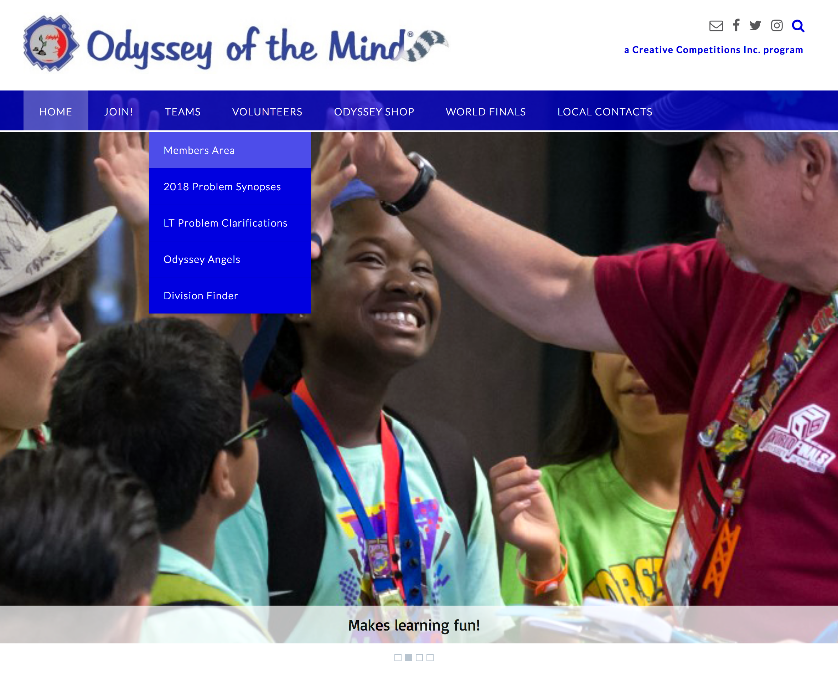
Odyssey of the Mind Homepage
National Membership Registration
Enter Member Area
General Clarifications

Slide 4
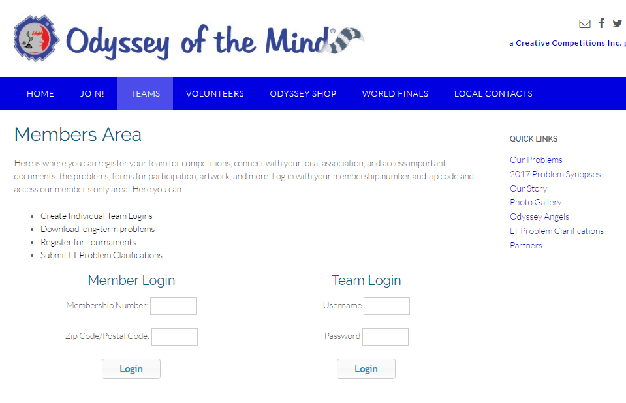
Entering Member Area
Enter Membership # and Zip Code

Slide 5
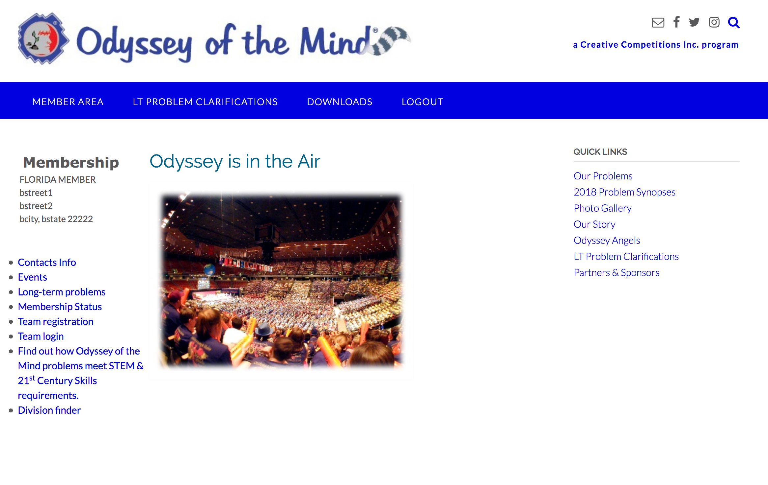
Member Area
Submit team specific clarifications
Forms, Problems and More!
Learn how Odyssey meets educational initiatives

Slide 6
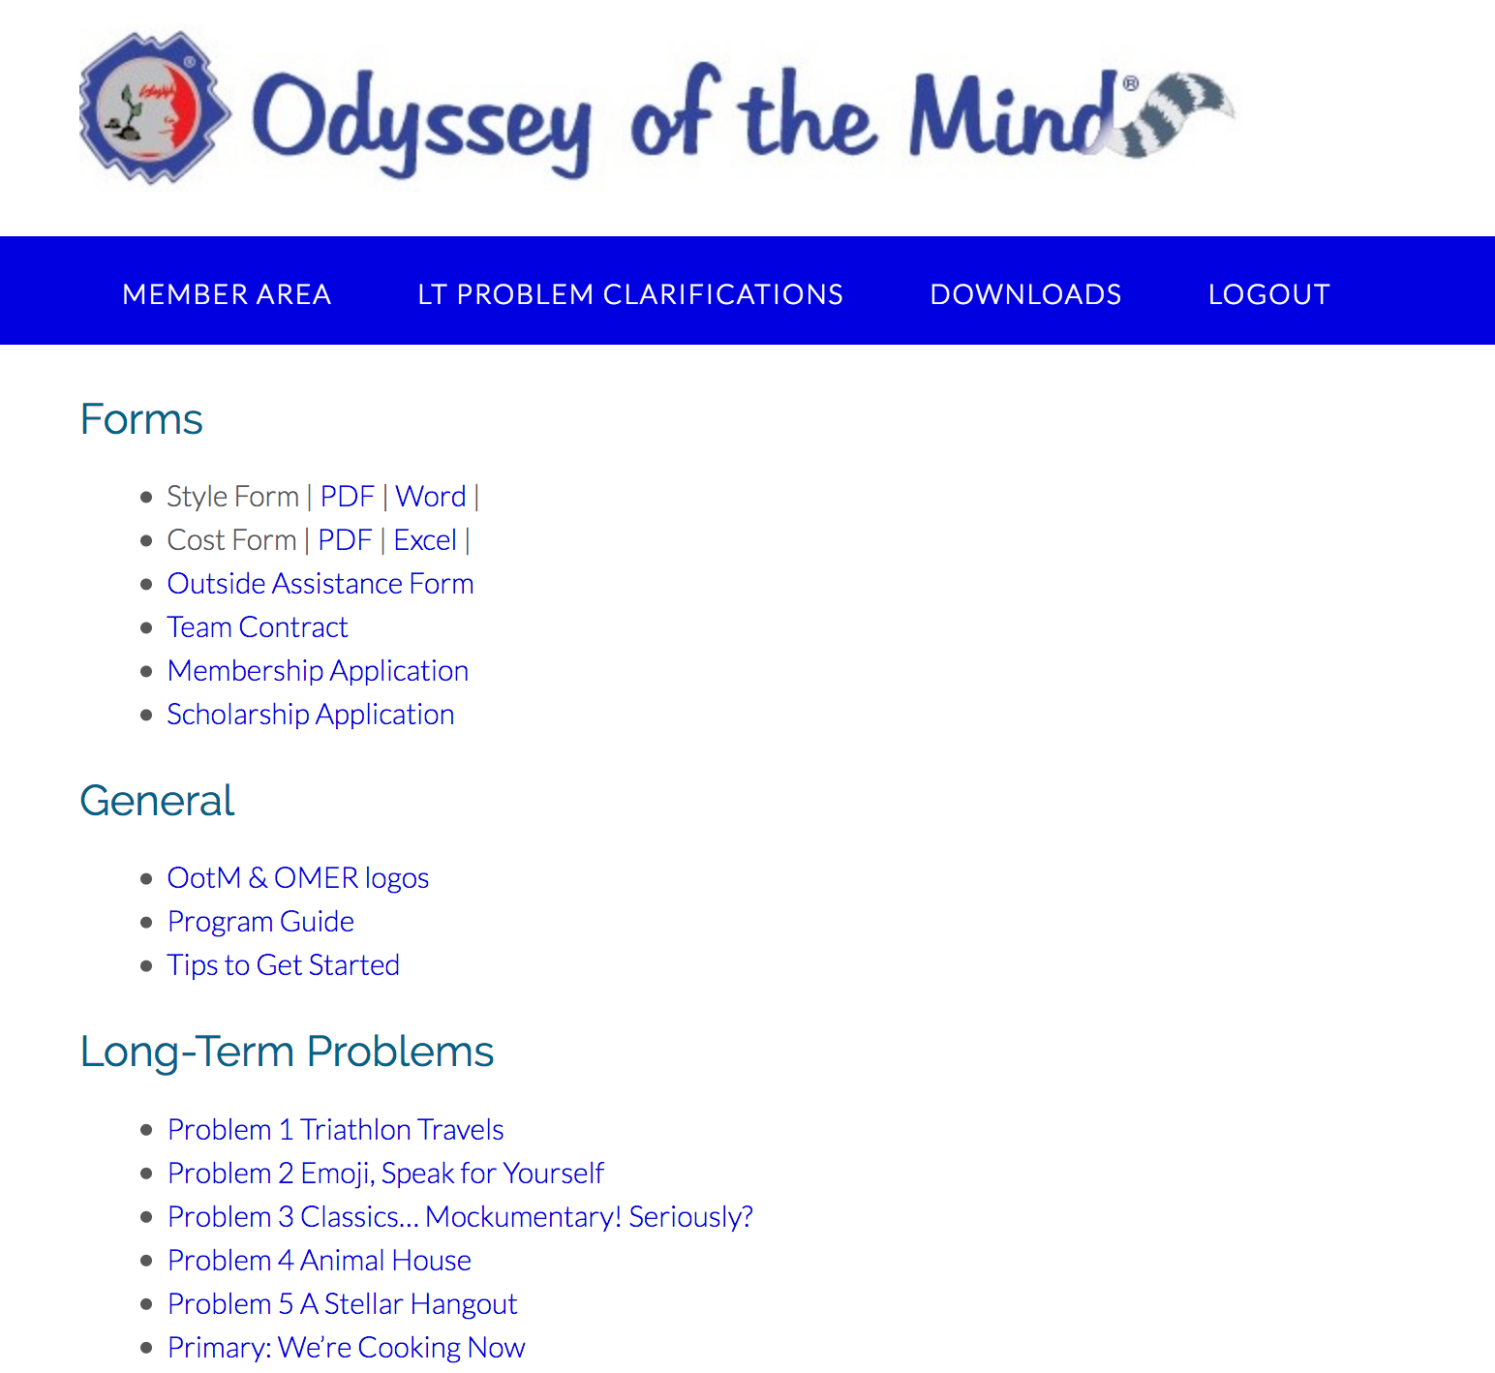
Forms & Problem Area
Forms – Sample Team Contract
National COU Scholarship
Program Guide - Logos
PDF versions of the problems.

Slide 7
Member Area

Slide 8
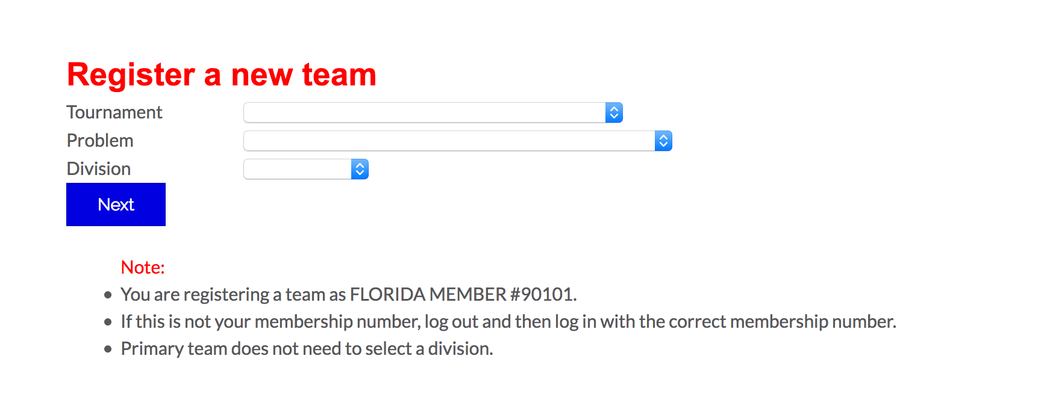
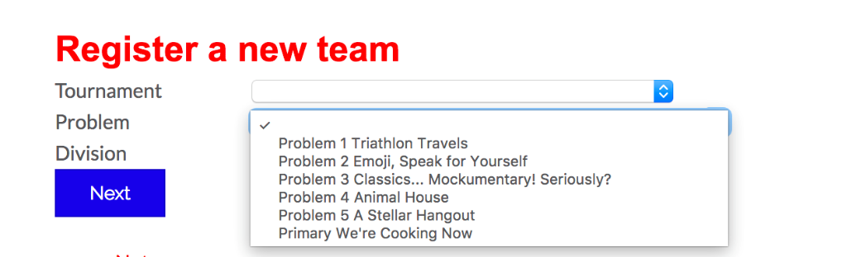
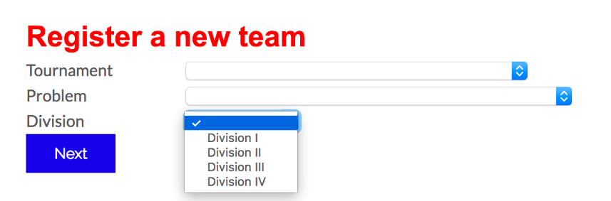
Begin TEAM Registration
Select Regional Tournament, Problem and Division

Slide 9
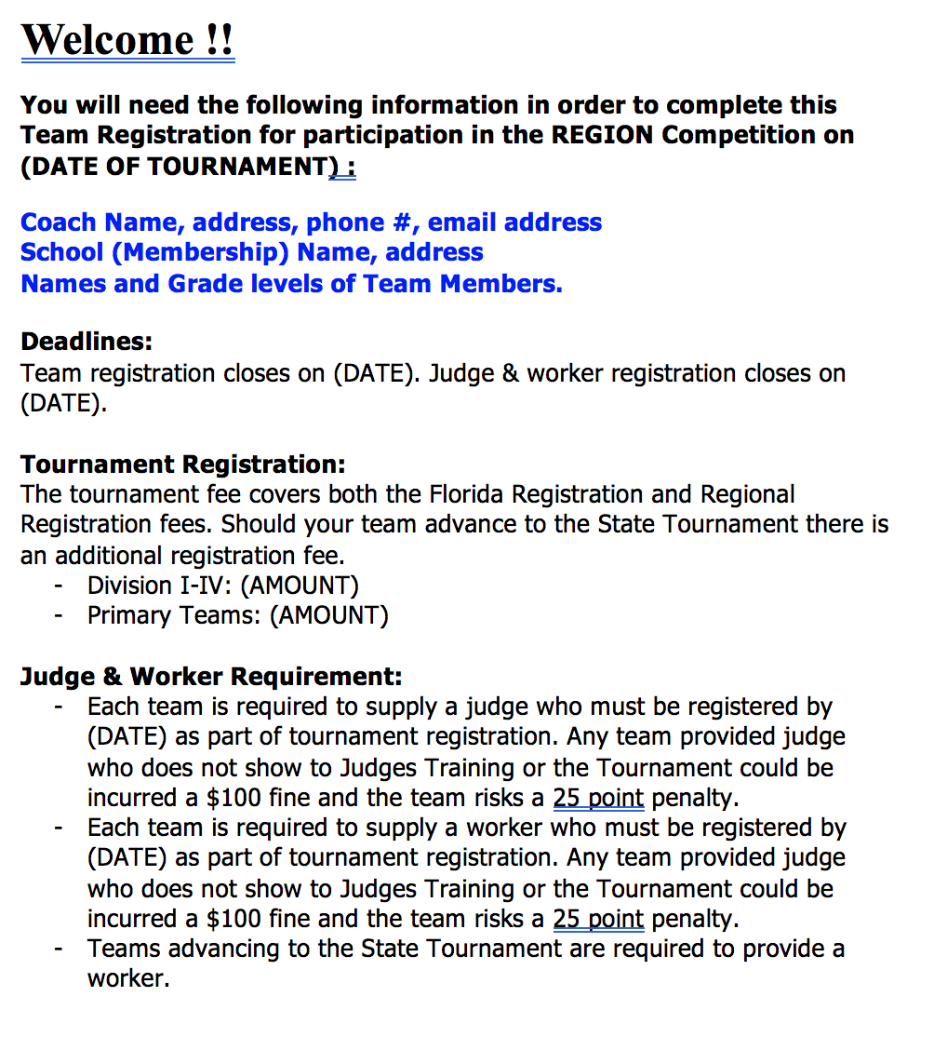
Welcome Screen (Part 1)
Team Registration Fee Information
Judge & Volunteer Requirement
This will be customized for each Regional Tournament

Slide 10
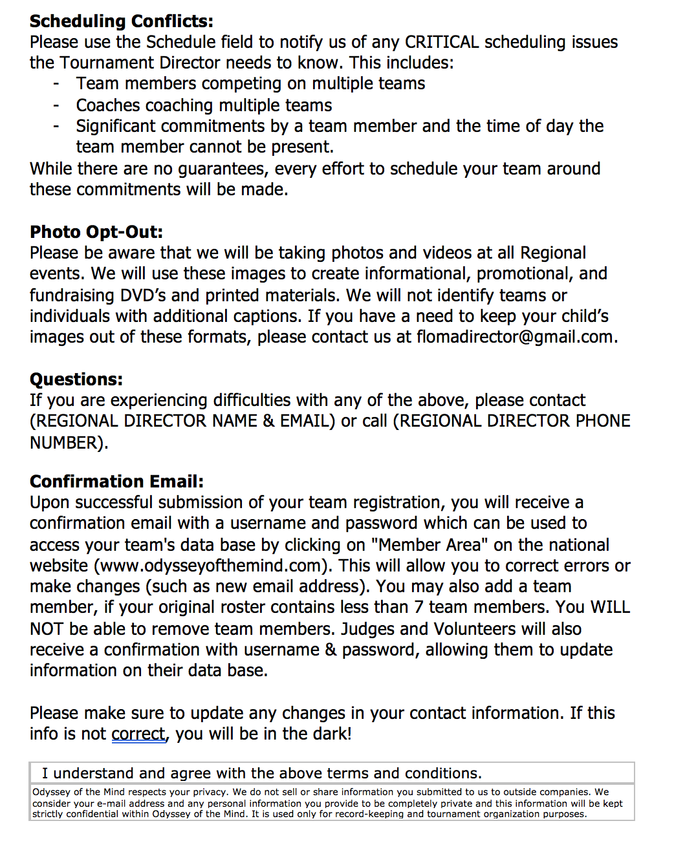
Welcome Screen (Part 2)
Notify us of scheduling conflicts
This will be customized for each Regional Tournament
Please read then check box, then click Next Step

Slide 11
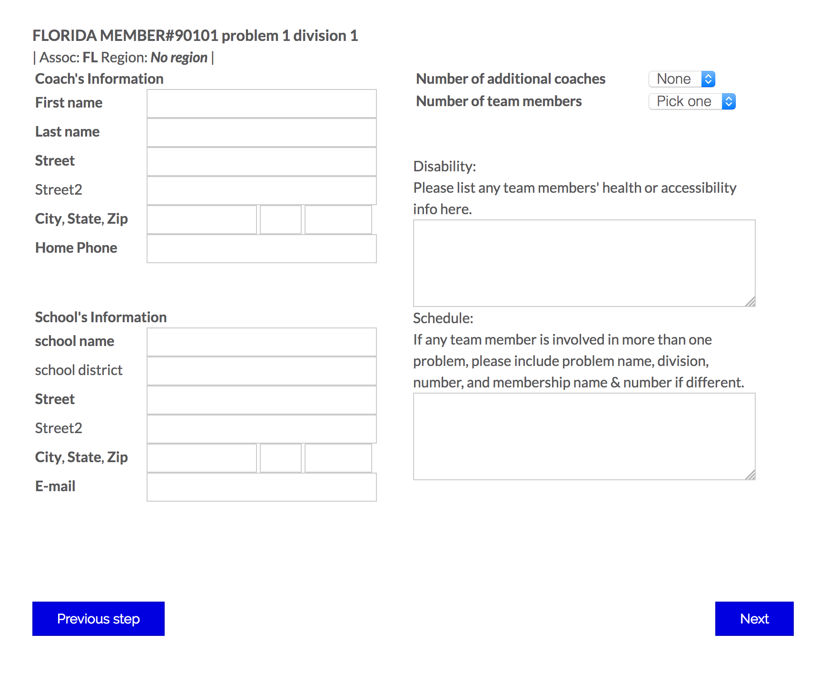
Entering Team Information
Membership name, #, team & divisions
Enter Coach Information
Enter any disabilities/
allergies of a team member or coach
Enter schedule conflict
Pre-Populated based off Membership Info
This screen could also include Media Release and Training Information.
Click Next

Slide 12
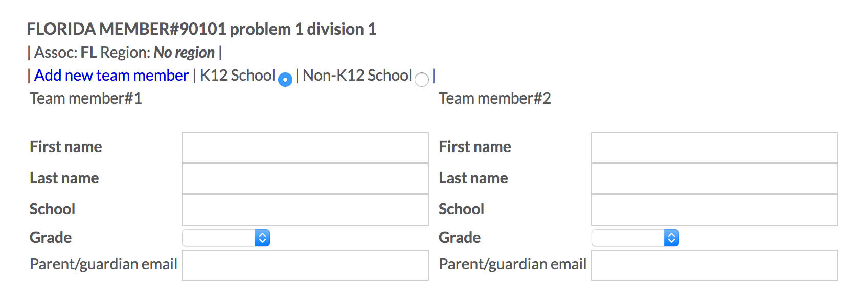
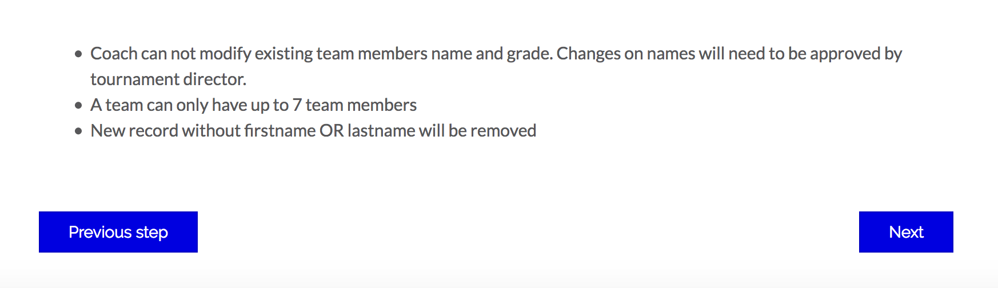
Team Members Page
Click this link to add team member.
Important: Changing team member information will need to be approved by AD or RD
Enter team member information

Slide 13
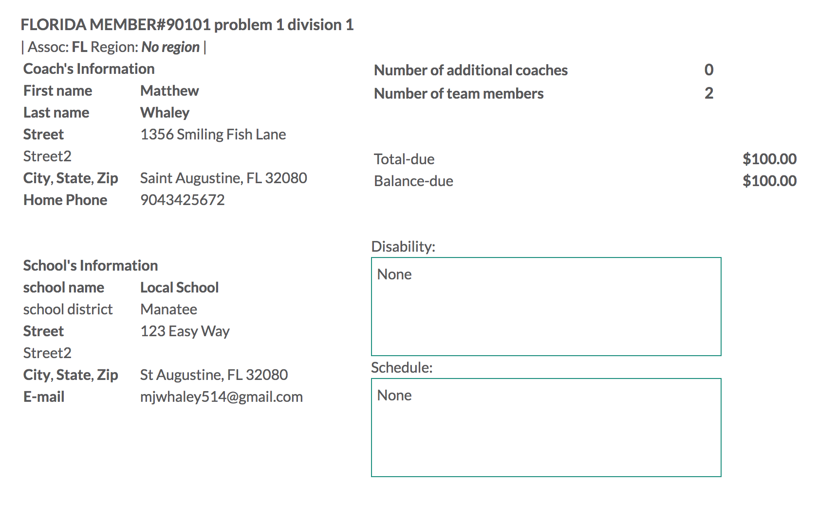
Top Half Review Page
Florida
Coach
1 Any Street
St Augustine, FL 32080
(904) 555-5555
AMOUNT WILL REFLECT TEAM & REGIONAL REGISTRATION FEES
FLORIDA MEMBER
St Johns
1 Any Street
St Augustine, FL 32080
flomadirector@gmail.com

Slide 14
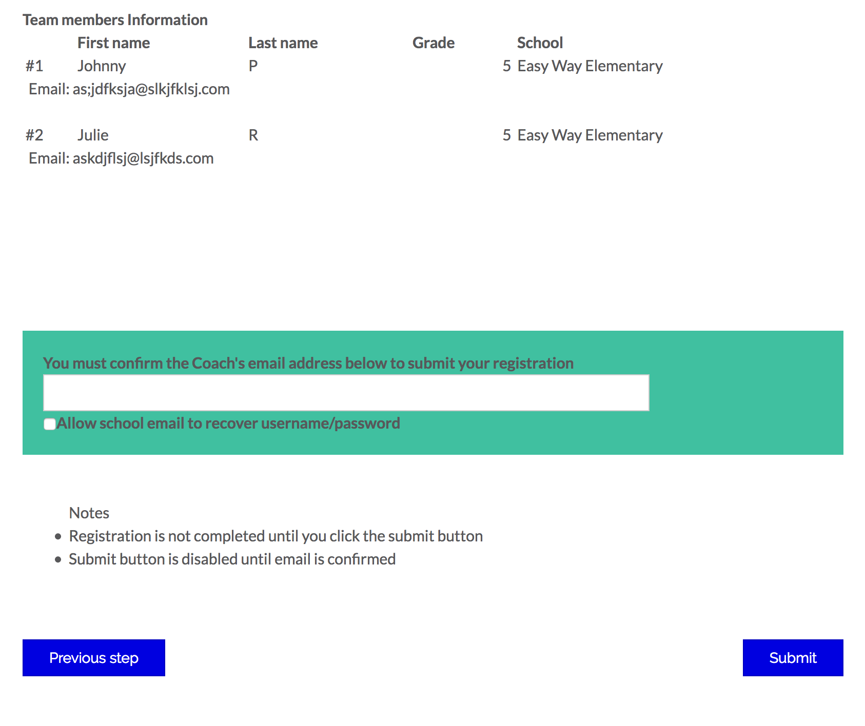
Bottom Half Review Page
Must re-enter coach email before clicking Submit
Submit button will not be active till the coaches email has been entered

Slide 15
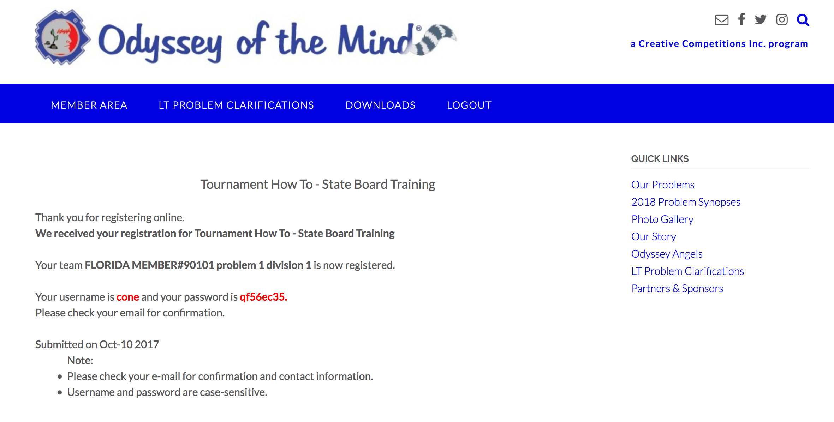
Confirmation Page
Will receive email confirmation with username, password & link to payment site

Slide 16
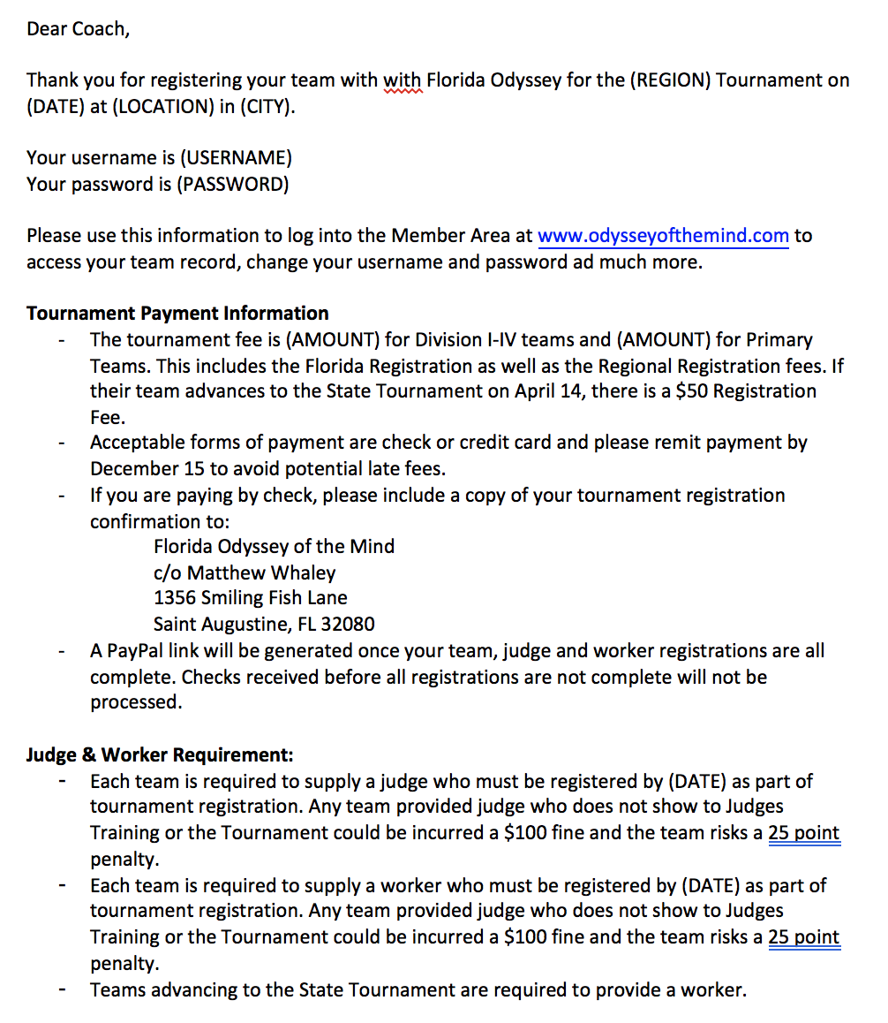
Confirmation Email – Top Half
Will receive email confirmation with your username & password
Link to pay tournament fee with Credit Card. Will not be active until Worker & Judge Information completed.
School Coordinator & Regional Director copied on email confirmation

Slide 17
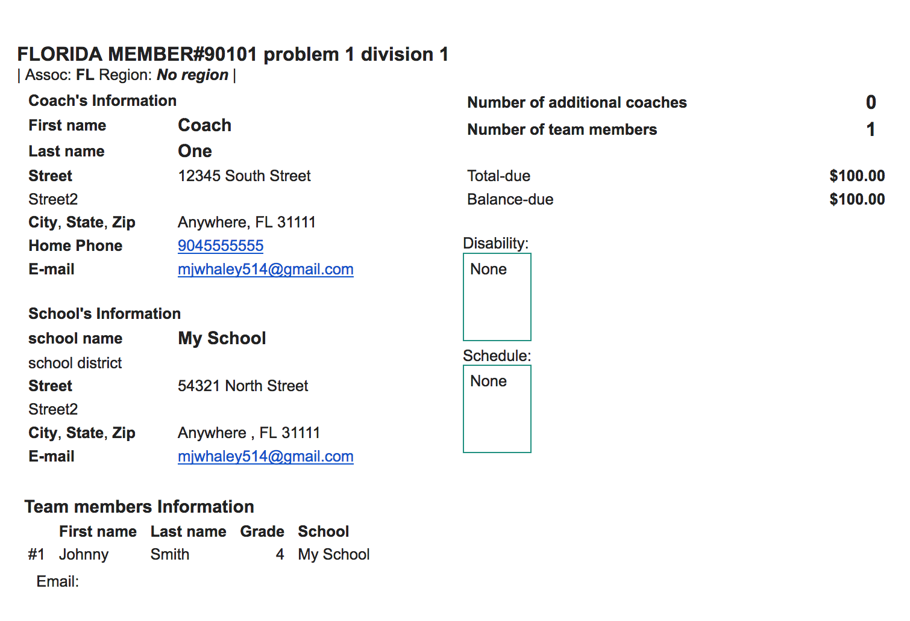
Confirmation Email-Lower Half
Coach Information
Membership Information
Use this email as an invoice with balance due information
Team Member’s Information

Slide 18
Entering Member Area
Click Login as Team

Slide 19
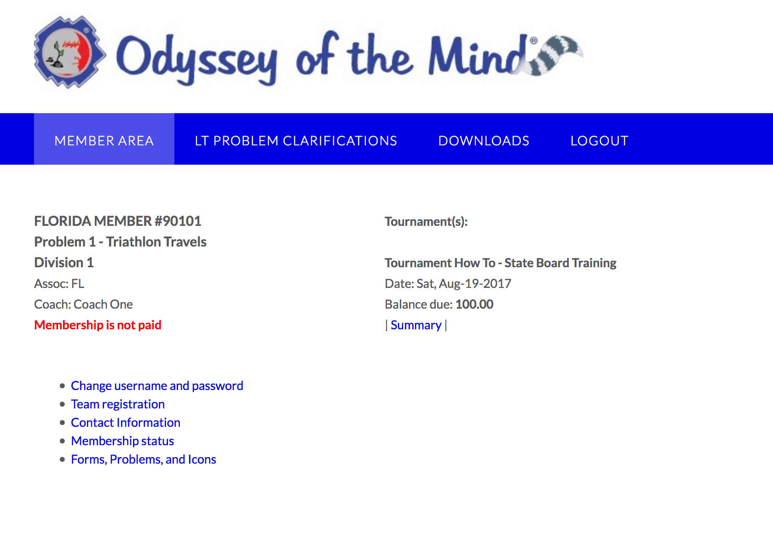
Team Area
Record cannot be modified till team is paid.
Change your username & password to something you can remember ☺

Slide 20
Email Confirmations
Coordinators (Email given with Initial Membership)
  Copied on team/tournament registration
    Includes coaches username & password
    Includes link to payment site
  Copied on judge & worker confirmation email
    Includes judge username & password
Coaches
  Copied on judge & worker confirmation email

Slide 21
What Can coordinators & Coaches Do Online?
Coaches with the username and password can submit requests to modify the team records or remove team members online.
  AD or RD must approve
A coach can add up to 7 team members online.
A coach can change his/her username and password.
A coach can not change the membership name, membership number, problem and division of the team. (directors can do this)

